Slide 1
Quality Assurance of Software and Information Systems

Slide 2
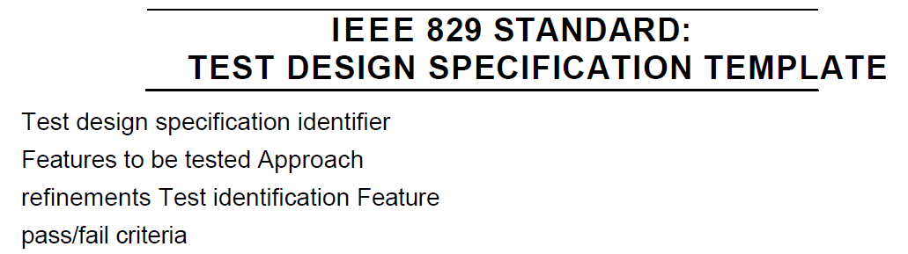
Concepts: Test Condition
An item or event of a component or system that could be verified by one or more test cases, e.g. A function, transaction, feature, quality attribute, or structural element.
Located in the test analysis & design specification document
Need to be prioritized

Slide 3
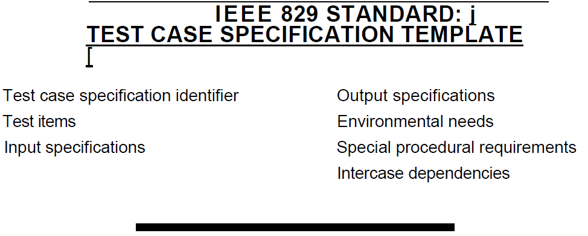
Concepts : Test Case
A set of input values, execution preconditions, expected results and execution post conditions, developed for a particular objective(s) or test condition(s), such as to exercise a particular program path or to verify compliance with a specific requirement.
Located in the test case specification document
A test case can cover more than one test condition
Need to be prioritized

Slide 4
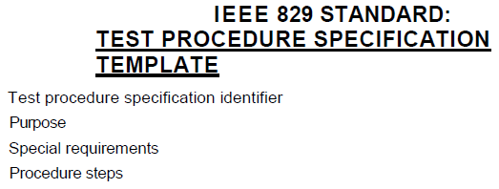
Concepts : Test Procedure
A sequence of actions for the execution of a test.
Located in the test procedure specification document

Slide 5
The Test Development Process
Decide on a test condition, which would typically be a small section of the specification for our software under test. (Analysis)
Design a test case that will verify the test condition(s) or test objective(s). Expected results should be produced as part of the specification of a test case and include outputs, changes to data and states, and any other consequences of the test. (Design)
Write a test procedure to execute the test, i.e. Get it into the right starting state, input the values, and check the outcome. (Implementation)
If tests are run using a test execution tool, the sequence of actions is specified in a test script (which is an automated test procedure).
To test a whole system we write a test execution schedule, which puts all the individual test procedures in the right sequence and sets up the system so that they can be run.

Slide 6
Static Testing & Dynamic Testing
Static and Dynamics testing are important testing methods available for developers and testers.
These are software testing technique in which the organization must choose carefully which to implement on the software application.

Slide 7
1- Static Testing Techniques
Static testing manually checks the code, requirement documents, design documents, test plan and Test scripts to find errors. Hence, it is called as static.
Static testing techniques are those techniques that test software without executing the code.
It is also called a verification Testing.

Slide 8
2- Dynamic Testing Technique
Dynamic Testing checks for functional behavior of software system, CPU usage and overall performance of the system. Hence, it is called Dynamic.
(by running software)
Dynamic testing is also known as validation testing, evaluating the finished product.

Slide 9
Review Process
A review is a systematic examination of a document by one or more people with the main aim of finding and removing errors.
Giving a draft document to a colleague to read is the simplest example of a review

Slide 10
What can be Reviewed?
Policy, strategy, business plans, marketing or advertising material, contracts
System requirements, feasibility studies, acceptance test plans
Test plans, test designs, test cases, test results
System designs, logical & physical
Software code
User manuals, procedures, training material

Slide 11
Roles and Responsibilities
Leader / moderator
Decides what to be reviewed
chooses participants,
conducts the meeting,
performs follow-up,
Author
Reviewers / Inspectors
specialised fault-finding roles for Inspection
Managers
plans the review / Inspection
Allocates time in the project plan for the review
Don’t need to get involved in actually review
Scribe / Recorder
Records all issues in the review meeting

Slide 12
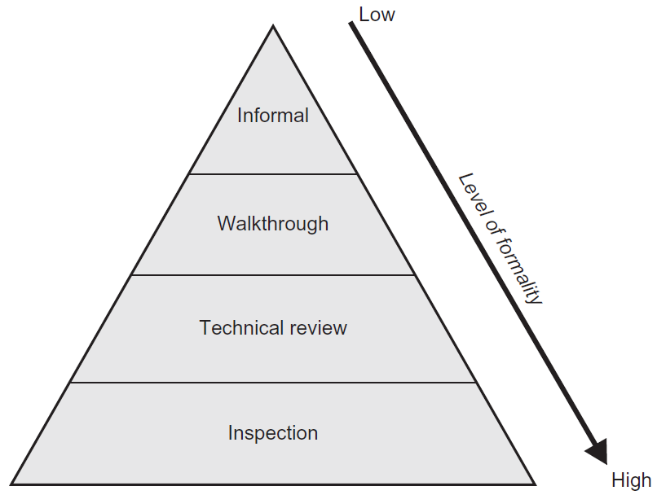
Types of Reviews
Informal reviews
Walkthrough
Technical reviews
Inspection
Notes:
48

Slide 13
Informal Review
Informal process
May take the form of pair programming or a technical lead reviewing designs and code
Results usually not documented
Main purpose: inexpensive way to get some benefit and find defects
Notes:
48

Slide 14
2. Walkthrough
Meeting led by author
May take the form of scenarios, dry runs, peer group participation
Open-ended sessions
Optional pre-meeting preparation of reviewers
Optional preparation of a review report including list of findings
Optional scribe (who is not the author)
May vary in practice from quite informal to very form a Main purposes: learning, gaining understanding, gathering information, finding defects
Notes:
48

Slide 15
3. Technical Review
Documented, defined defect-detection process that includes peers and technical experts with optional management participation
Ideally led by trained moderator (not the author)
Pre-meeting preparation by reviewers
Optional use of checklists
Preparation of a review report which includes the list of findings, the verdict whether the software product meets its requirements and, where appropriate, recommendations related to Findings
Main purposes: discussing, making decisions, evaluating alternatives, finding defects, solving technical problems and checking conformance to specifications, plans, regulations, and Standards
Notes:
48

Slide 16
4- Inspection
Led by trained moderator (not the author)
Usually conducted as a peer examination
Defined roles, metrics gathering
Formal process based on rules and checklists
Specified entry and exit criteria for acceptance of the software product
Pre-meeting preparation
Inspection report including list of findings
Formal follow-up process
Optional reader
Main purpose: finding defects, optional process improvement
Notes:
48

Slide 17
THANK YOU

